Slide 1
ECON1002 Intro. Macro.
Tutorial 9
Herbert Xin
wei.xin@sydney.edu.au

Slide 2
Plan of Today
Concept Review
Tutorial Questions
Preparation for Essay Task
Due: May 11th

Slide 3
Concept Review

Slide 4
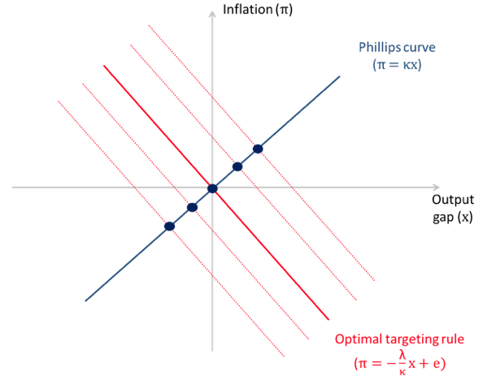
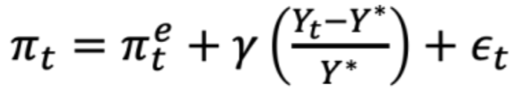
Phillips Curve
Inflation changes when the economy is above/below potential and if there is a cost-push shock

Slide 5
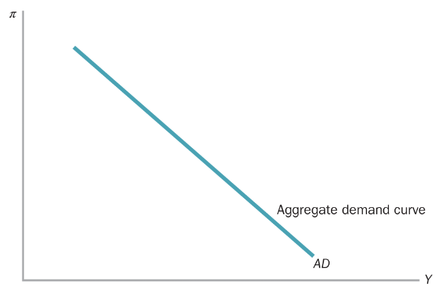
The AD Curve
Why is AD curve downward slopping?

Slide 6
The AD Curve
Why is AD curve downward slopping?
Central Bank behavior

Slide 7
The AD Curve
Why is AD curve downward slopping?
Central Bank behavior
(Negative) income effect

Slide 8
The AD Curve
Why is AD curve downward slopping?
Central Bank behavior
(Negative) income effect
Distributional effect (decrease spending through MPC of low-income households)

Slide 9
The AD Curve
Why is AD curve downward slopping?
Central Bank behavior
(Negative) income effect
Distributional effect (decrease spending through MPC of low-income households)
Uncertainty

Slide 10
The AD Curve
Why is AD curve downward slopping?
Central Bank behavior
(Negative) income effect
Distributional effect (decrease spending through MPC of low-income households)
Uncertainty
Decline in export

Slide 11
Policy Response Function
How does policy response function affect aggregate demand?

Slide 12
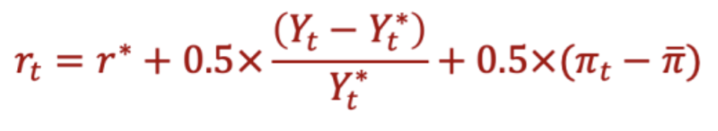
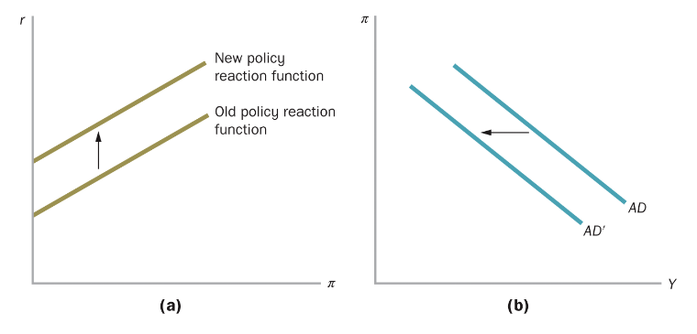

Policy Response Function
How does policy response function affect aggregate demand?
$$r→I→AD$$

Slide 13
Short-run & Long-run
What is the difference between short-run and long-run aggregate supply?

Slide 14
Short-run & Long-run
What is the difference between short-run and long-run aggregate supply?
Short-run: firms produce quantities that meet demand

Slide 15
Short-run & Long-run
What is the difference between short-run and long-run aggregate supply?
Short-run: firms produce quantities that meet demand
Long-run: depends on potential output (the “real things”)

Slide 16
Short-run & Long-run
What is the difference between short-run and long-run aggregate supply?
Short-run: firms produce quantities that meet demand
Long-run: depends on potential output (the “real things”)
The economy as a whole will move (converge) from the short-run general equilibrium to the long-run general equilibrium

Slide 17
An Interesting Website
Interactive Economics graphs

Slide 18
Tutorial Questions
… from Tut 6

Slide 19
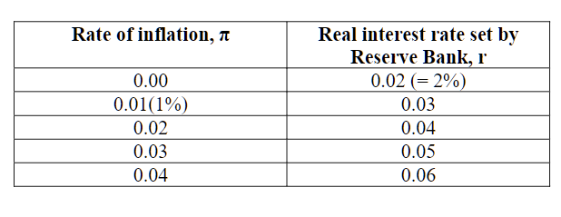

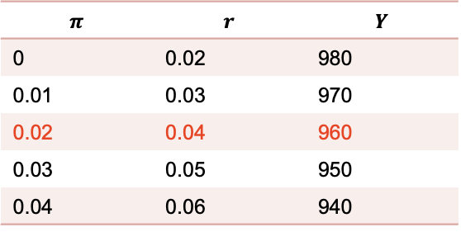
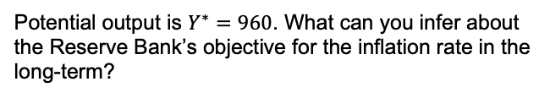
Question 3
Suppose the Reserve Bank follows the following policy reaction function.
$$π$$ | $$r$$ | $$Y$$
0 | 0.02 | 980
0.01 | 0.03 | 970
0.02 | 0.04 | 960
0.03 | 0.05 | 950
0.04 | 0.06 | 940
For this economy, the relationship between short-run equilibrium output Y and the real interest rate r set by the Reserve Bank is given by
$$Y=1000−1000r$$
Potential output is $Y^{∗}=960$. What can you infer about the Reserve Bank’s objective for the inflation rate in the long-term?

Slide 20
Question 3
Suppose the Reserve Bank follows the following policy reaction function.
$$π$$ | $$r$$ | $$Y$$
0 | 0.02 | 980
0.01 | 0.03 | 970
0.02 | 0.04 | 960
0.03 | 0.05 | 950
0.04 | 0.06 | 940
For this economy, the relationship between short-run equilibrium output Y and the real interest rate r set by the Reserve Bank is given by
When the inflation is high, RBA tries to increase policy rate to cool down the economy. When inflation is low, RBA lowers the rate to boost the economy, i.e. RBA is trying to do what we called “inflation targeting.”
$$Y=1000−1000r$$
Potential output is $Y^{∗}=960$. What can you infer about the Reserve Bank’s objective for the inflation rate in the long-term?

Slide 21
Tutorial Questions
… from Tut 8

Slide 22
Question 1
Suppose that the government cuts taxes in response to a recessionary gap, but because of legislative delays the tax cut is not put in place for 18 months. Using an AD–AS diagram and assuming that the government’s objective is to stabilize output and inflation, show how this policy action might actually prove to be counterproductive.

Slide 23
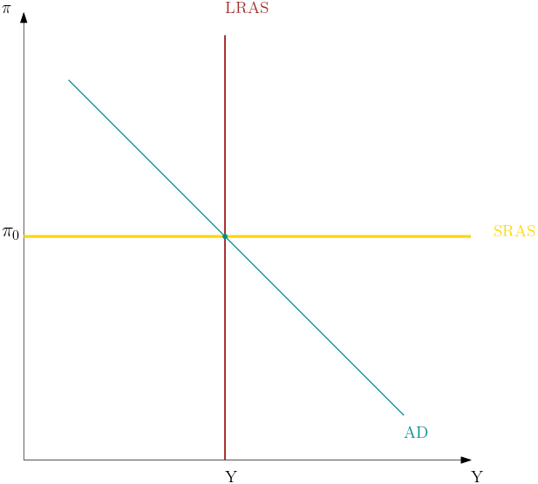
Question 1
Suppose that the government cuts taxes in response to a recessionary gap, but because of legislative delays the tax cut is not put in place for 18 months. Using an AD–AS diagram and assuming that the government’s objective is to stabilize output and inflation, show how this policy action might actually prove to be counterproductive.

Slide 24
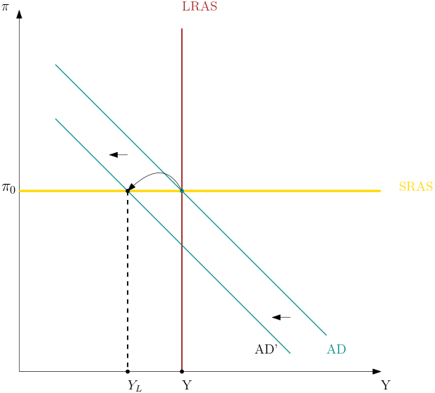
Question 1
Suppose that the government cuts taxes in response to a recessionary gap, but because of legislative delays the tax cut is not put in place for 18 months. Using an AD–AS diagram and assuming that the government’s objective is to stabilize output and inflation, show how this policy action might actually prove to be counterproductive.

Slide 25
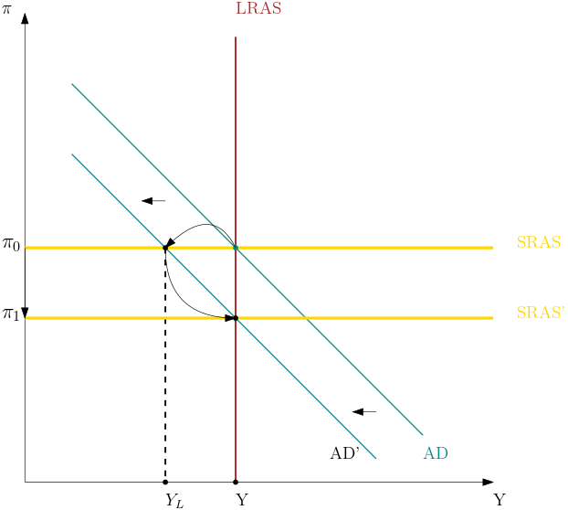
Question 1
Suppose that the government cuts taxes in response to a recessionary gap, but because of legislative delays the tax cut is not put in place for 18 months. Using an AD–AS diagram and assuming that the government’s objective is to stabilize output and inflation, show how this policy action might actually prove to be counterproductive.

Slide 26
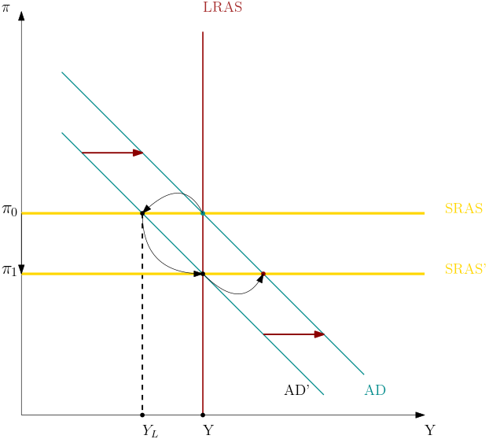
Question 1
Suppose that the government cuts taxes in response to a recessionary gap, but because of legislative delays the tax cut is not put in place for 18 months. Using an AD–AS diagram and assuming that the government’s objective is to stabilize output and inflation, show how this policy action might actually prove to be counterproductive.

Slide 27

Question 1
Suppose that the government cuts taxes in response to a recessionary gap, but because of legislative delays the tax cut is not put in place for 18 months. Using an AD–AS diagram and assuming that the government’s objective is to stabilize output and inflation, show how this policy action might actually prove to be counterproductive.

Slide 28
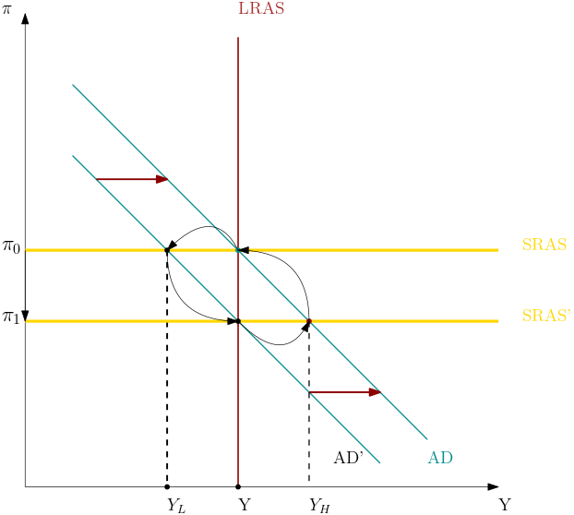
Question 1
Suppose that the government cuts taxes in response to a recessionary gap, but because of legislative delays the tax cut is not put in place for 18 months. Using an AD–AS diagram and assuming that the government’s objective is to stabilize output and inflation, show how this policy action might actually prove to be counterproductive.

Slide 29
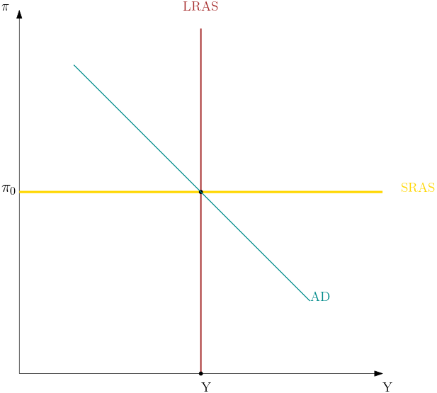
Question 2
Suppose that a permanent increase in oil prices creates an inflationary shock and reduces potential output. Use an AD-AS diagram to show the effects of the oil price increase on output and inflation in the short-run and the long-run, assuming that there is no policy response. What happens if the Reserve Bank responds to the oil price increase by tightening monetary policy?

Slide 30
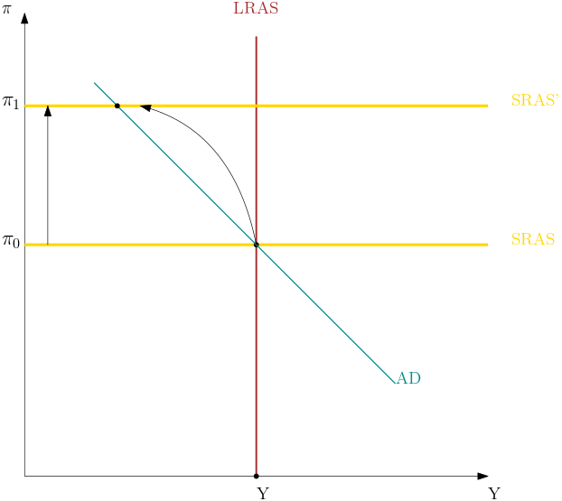
Question 2
Suppose that a permanent increase in oil prices creates an inflationary shock and reduces potential output. Use an AD-AS diagram to show the effects of the oil price increase on output and inflation in the short-run and the long-run, assuming that there is no policy response. What happens if the Reserve Bank responds to the oil price increase by tightening monetary policy?

Slide 31
Question 2
Suppose that a permanent increase in oil prices creates an inflationary shock and reduces potential output. Use an AD-AS diagram to show the effects of the oil price increase on output and inflation in the short-run and the long-run, assuming that there is no policy response. What happens if the Reserve Bank responds to the oil price increase by tightening monetary policy?

Slide 32
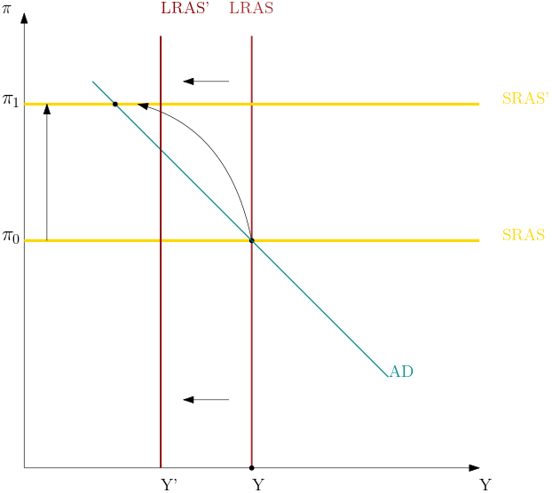
Question 2
Suppose that a permanent increase in oil prices creates an inflationary shock and reduces potential output. Use an AD-AS diagram to show the effects of the oil price increase on output and inflation in the short-run and the long-run, assuming that there is no policy response. What happens if the Reserve Bank responds to the oil price increase by tightening monetary policy?

Slide 33
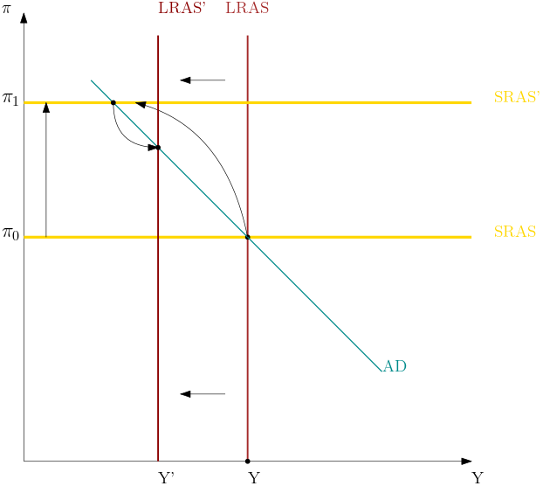
Question 2
Suppose that a permanent increase in oil prices creates an inflationary shock and reduces potential output. Use an AD-AS diagram to show the effects of the oil price increase on output and inflation in the short-run and the long-run, assuming that there is no policy response. What happens if the Reserve Bank responds to the oil price increase by tightening monetary policy?

Slide 34
Question 2
Suppose that a permanent increase in oil prices creates an inflationary shock and reduces potential output. Use an AD-AS diagram to show the effects of the oil price increase on output and inflation in the short-run and the long-run, assuming that there is no policy response. What happens if the Reserve Bank responds to the oil price increase by tightening monetary policy?

Slide 35
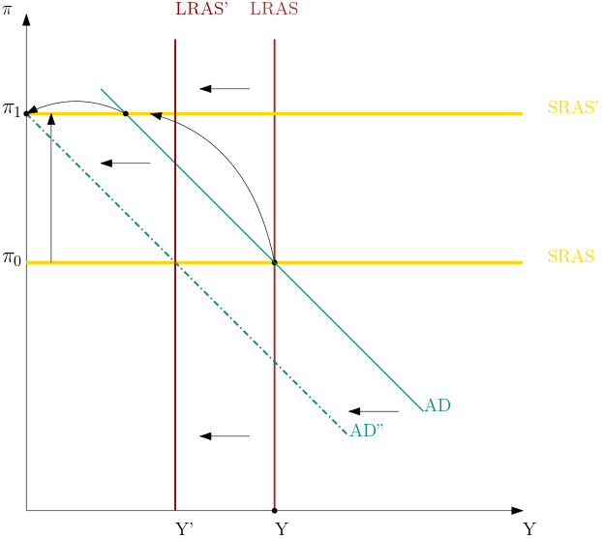

Question 2
Bad scaling!!
Suppose that a permanent increase in oil prices creates an inflationary shock and reduces potential output. Use an AD-AS diagram to show the effects of the oil price increase on output and inflation in the short-run and the long-run, assuming that there is no policy response. What happens if the Reserve Bank responds to the oil price increase by tightening monetary policy?

Slide 36
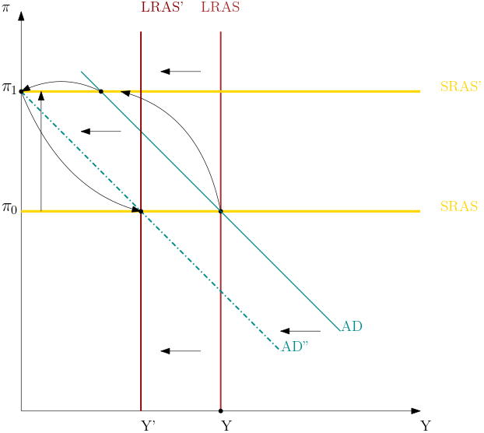
Question 2
Bad scaling!!
Suppose that a permanent increase in oil prices creates an inflationary shock and reduces potential output. Use an AD-AS diagram to show the effects of the oil price increase on output and inflation in the short-run and the long-run, assuming that there is no policy response. What happens if the Reserve Bank responds to the oil price increase by tightening monetary policy?

Slide 37
Question 2
Bad scaling!!
Suppose that a permanent increase in oil prices creates an inflationary shock and reduces potential output. Use an AD-AS diagram to show the effects of the oil price increase on output and inflation in the short-run and the long-run, assuming that there is no policy response. What happens if the Reserve Bank responds to the oil price increase by tightening monetary policy?
Depends on quality of policy

Slide 38
Question 3
Explain how a disinflationary macroeconomic policy (e.g. a contractionary monetary policy) can successfully reduce the inflation rate to a permanently lower level. Use the AD-AS model to describe the initial policy actions, a short run equilibrium, adjustment process toward a new long run equilibrium.

Slide 39
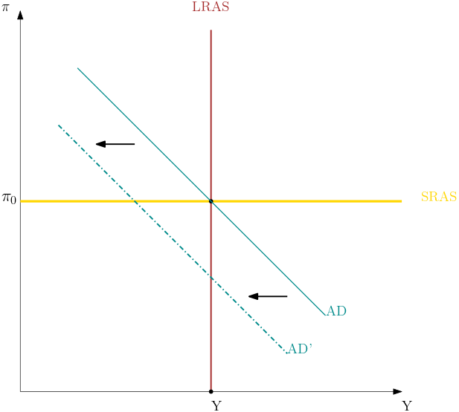
Question 3
Explain how a disinflationary macroeconomic policy (e.g. a contractionary monetary policy) can successfully reduce the inflation rate to a permanently lower level. Use the AD-AS model to describe the initial policy actions, a short run equilibrium, adjustment process toward a new long run equilibrium.

Slide 40
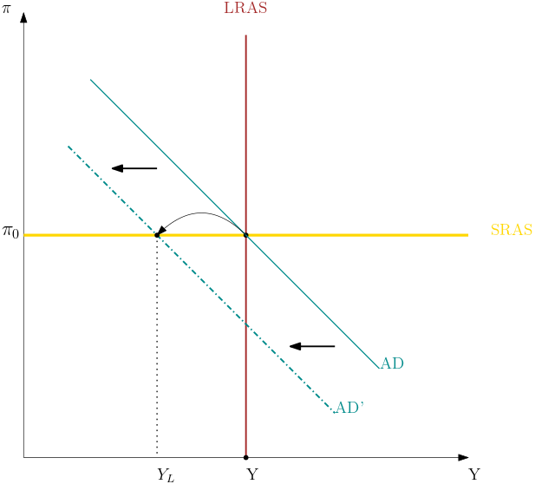
Question 3
Explain how a disinflationary macroeconomic policy (e.g. a contractionary monetary policy) can successfully reduce the inflation rate to a permanently lower level. Use the AD-AS model to describe the initial policy actions, a short run equilibrium, adjustment process toward a new long run equilibrium.

Slide 41
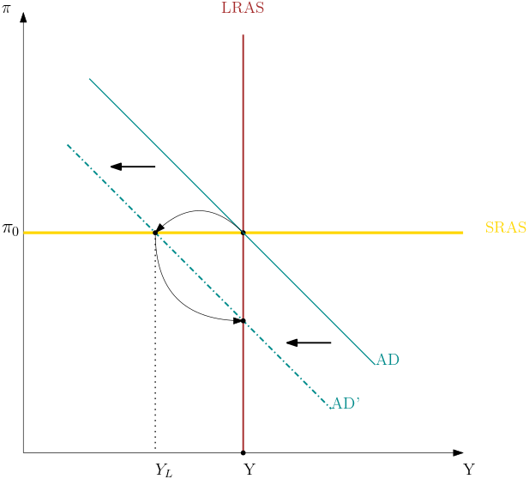
Question 3
Explain how a disinflationary macroeconomic policy (e.g. a contractionary monetary policy) can successfully reduce the inflation rate to a permanently lower level. Use the AD-AS model to describe the initial policy actions, a short run equilibrium, adjustment process toward a new long run equilibrium.

Slide 42
Question 3
Explain how a disinflationary macroeconomic policy (e.g. a contractionary monetary policy) can successfully reduce the inflation rate to a permanently lower level. Use the AD-AS model to describe the initial policy actions, a short run equilibrium, adjustment process toward a new long run equilibrium.

Slide 43
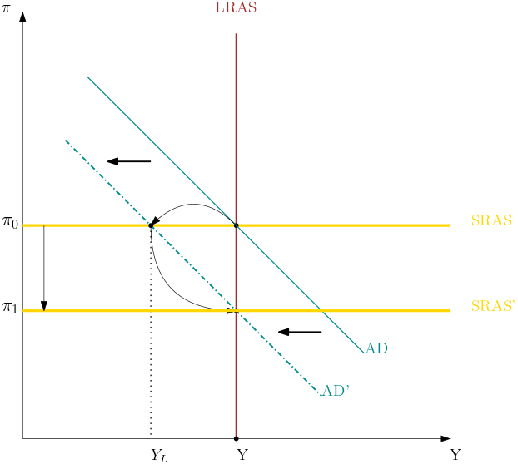
Question 3
Explain how a disinflationary macroeconomic policy (e.g. a contractionary monetary policy) can successfully reduce the inflation rate to a permanently lower level. Use the AD-AS model to describe the initial policy actions, a short run equilibrium, adjustment process toward a new long run equilibrium.

Slide 44
Preparation for Essay Task

Slide 45
Question 4
Explain the recent increase of interest rates and changes in fiscal policy as a response to inflation in Australia.
Engage in a conversation with Bing Copilot so it gives the most accurate response
Think how the response you got could be further improved
Think of extra explanation and analysis using relevant theories, graphs, equations, or other evidence.

Slide 46
Question 4
Interest Rate Hikes:
Background: From May to October 2022, the Reserve Bank of Australia (RBA) implemented a series of interest rate hikes. The overnight cash rate target was raised from 0.1% to 2.6% to address inflationary pressures.
Inflation Concerns: Australia experienced a surge in inflation, with headline inflation reaching 5.4% annually in the September quarter—well above the RBA’s target range of 2-3%. The RBA’s preferred measure of inflation also exceeded expectations, adding pressure for interest rates to rise.
Policy Response: The RBA’s actions aimed to curb inflation by making borrowing more expensive. These rate hikes were a proactive measure to stabilize the economy and manage rising prices.
Fiscal Policy Adjustments:
Government Decisions: The Australian government made significant policy decisions. These included increases in payments, anticipated to cost the budget $68.3 billion over the period up to 2024-25, and reductions in receipts due to tax cuts and concessions, which are expected to reduce the underlying cash balance by $27.6 billion over the same period.
Challenges: Despite improvements in medium-term projections (lower gross debt as a percentage of GDP and smaller underlying cash deficits), new challenges emerged. These include high inflation, rising interest rates, and structural expenditure risks related to aging and climate change.
Balancing Act: The government faces the task of balancing expenditure needs while ensuring fiscal sustainability. Interventions should align with past approaches, emphasizing periods of consolidation.
Long-Term Fiscal Sustainability:
Analysis: The RBA’s fiscal sustainability analysis examines scenarios combining assumptions for economic growth, interest rates, and the budget balance. These scenarios result in higher debt-to-GDP ratios compared to previous analyses.
Sustainable Position: Despite challenges, the fiscal position remains sustainable in most scenarios. However, governments must continue to act to ensure long-term fiscal stability. Periods of consolidation will be necessary, but historical approaches can guide effective interventions.
Conclusion:
Uncertain Global Environment: Australia’s recovery from the acute effects of the COVID-19 pandemic has been positive, but uncertainties persist globally.
Inflation and Interest Rates: The recent interest rate hikes respond to inflationary pressures, while fiscal policy adjustments aim to strike a balance between addressing challenges and maintaining sustainability.
Collaboration: The RBA, government, and policymakers must work together to navigate economic complexities and ensure Australia’s financial resilience.
My prompt: Explain the recent increase of interest rates and changes in fiscal policy as a response to inflation in Australia in an essay with four paragraphs
What weaknesses do you see?

Slide 47
Question 4
Interest Rate Hikes:
Background: From May to October 2022, the Reserve Bank of Australia (RBA) implemented a series of interest rate hikes. The overnight cash rate target was raised from 0.1% to 2.6% to address inflationary pressures.
Inflation Concerns: Australia experienced a surge in inflation, with headline inflation reaching 5.4% annually in the September quarter—well above the RBA’s target range of 2-3%. The RBA’s preferred measure of inflation also exceeded expectations, adding pressure for interest rates to rise.
Policy Response: The RBA’s actions aimed to curb inflation by making borrowing more expensive. These rate hikes were a proactive measure to stabilize the economy and manage rising prices.
My prompt: Explain the recent increase of interest rates and changes in fiscal policy as a response to inflation in Australia in an essay with four paragraphs
What weaknesses do you see?

Slide 48
Question 4
Interest Rate Hikes:
Background: From May to October 2022, the Reserve Bank of Australia (RBA) implemented a series of interest rate hikes. The overnight cash rate target was raised from 0.1% to 2.6% to address inflationary pressures.
Inflation Concerns: Australia experienced a surge in inflation, with headline inflation reaching 5.4% annually in the September quarter—well above the RBA’s target range of 2-3%. The RBA’s preferred measure of inflation also exceeded expectations, adding pressure for interest rates to rise.
Policy Response: The RBA’s actions aimed to curb inflation by making borrowing more expensive. These rate hikes were a proactive measure to stabilize the economy and manage rising prices.
My prompt: Explain the recent increase of interest rates and changes in fiscal policy as a response to inflation in Australia in an essay with four paragraphs
Again, dot points.
What causes the high inflation?
Why RBA cares about inflation? Mandates? Inflation targeting?
It does mention a little bit about how tighter policy leads to low inflation, but only verbally. Plus, the transmission channel should be [interest rate → investment/consumption → aggregate demand → price level → inflation]
What weaknesses do you see?

Slide 49
Question 4
2. Fiscal Policy Adjustments:
Government Decisions: The Australian government made significant policy decisions. These included increases in payments, anticipated to cost the budget $68.3 billion over the period up to 2024-25, and reductions in receipts due to tax cuts and concessions, which are expected to reduce the underlying cash balance by $27.6 billion over the same period.
Challenges: Despite improvements in medium-term projections (lower gross debt as a percentage of GDP and smaller underlying cash deficits), new challenges emerged. These include high inflation, rising interest rates, and structural expenditure risks related to aging and climate change.
Balancing Act: The government faces the task of balancing expenditure needs while ensuring fiscal sustainability. Interventions should align with past approaches, emphasizing periods of consolidation.
My prompt: Explain the recent increase of interest rates and changes in fiscal policy as a response to inflation in Australia in an essay with four paragraphs
How did the fiscal policy respond to inflation?
What is the rationale behind the change is fiscal policy?
How do we explain this in model?
What weaknesses do you see?

Slide 50
Question 4
2. Fiscal Policy Adjustments:
Government Decisions: The Australian government made significant policy decisions. These included increases in payments, anticipated to cost the budget $68.3 billion over the period up to 2024-25, and reductions in receipts due to tax cuts and concessions, which are expected to reduce the underlying cash balance by $27.6 billion over the same period.
Challenges: Despite improvements in medium-term projections (lower gross debt as a percentage of GDP and smaller underlying cash deficits), new challenges emerged. These include high inflation, rising interest rates, and structural expenditure risks related to aging and climate change.
Balancing Act: The government faces the task of balancing expenditure needs while ensuring fiscal sustainability. Interventions should align with past approaches, emphasizing periods of consolidation.
My prompt: Explain the recent increase of interest rates and changes in fiscal policy as a response to inflation in Australia in an essay with four paragraphs
How did the fiscal policy respond to inflation?
What is the rationale behind the change is fiscal policy?
How do we explain this in model?
Ideally, we should use the AD/AS model to show
After COVID AD shifted right, creating inflationary pressures
Supply shocks after COVID plus the War in Ukraine shifted SRAS up via an inflation shock
Increase of interest rates changed the policy reaction function to shift AD to the left
Fiscal policy is changing to achieve the potential level of output
Whether LRAS have shifted.
What weaknesses do you see?

Slide 51
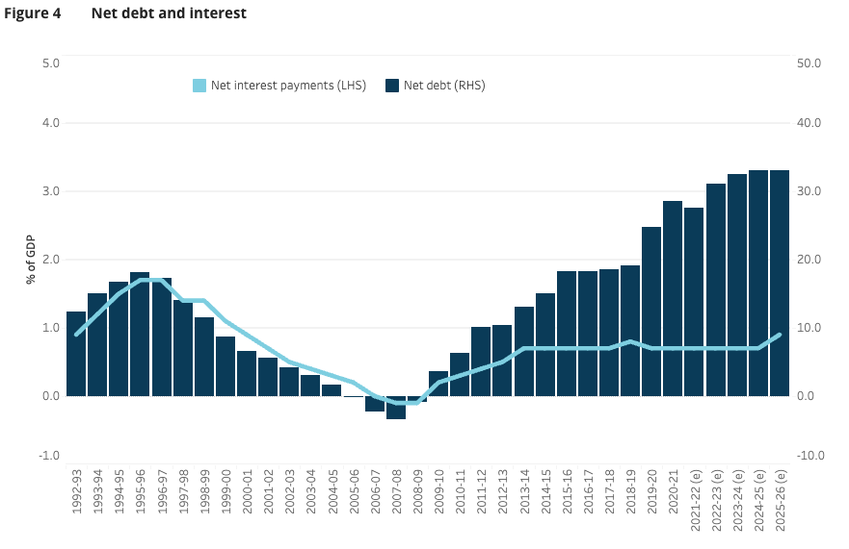
Question 4
2. Fiscal Policy Adjustments:
Government Decisions: The Australian government made significant policy decisions. These included increases in payments, anticipated to cost the budget $68.3 billion over the period up to 2024-25, and reductions in receipts due to tax cuts and concessions, which are expected to reduce the underlying cash balance by $27.6 billion over the same period.
Challenges: Despite improvements in medium-term projections (lower gross debt as a percentage of GDP and smaller underlying cash deficits), new challenges emerged. These include high inflation, rising interest rates, and structural expenditure risks related to aging and climate change.
Balancing Act: The government faces the task of balancing expenditure needs while ensuring fiscal sustainability. Interventions should align with past approaches, emphasizing periods of consolidation.
My prompt: Explain the recent increase of interest rates and changes in fiscal policy as a response to inflation in Australia in an essay with four paragraphs
How did the fiscal policy respond to inflation?
What is the rationale behind the change is fiscal policy
What weaknesses do you see?

Slide 52
Questions?

